Slide 1

SOWK 609B: School social work practice and policy
Session 2
Spring 2026
Binita M. Donohue, LCSW

Slide 2
Assignments Semester 2
FBA/BIP
SDS
Career Planning
Tier 2/3
Crisis Plan Analysis
Two parts
Care about process
Deidentify
Goals and learning process
Personal philosophy of SSW
Resume
EI intervention
Go for high interest
Prefer you look at school wide crises
What would I do if...

Slide 3

Opening Questions
What developmental age vs. chronological age?
How would you define Adaptive Behavior?
How would you specifically assess the impact of ”cultural factors” on a child?

Slide 4
Social Developmental Study
Social Worker’s contribution to the eligibility conference
Document that should be able to stand alone
Educational language (describe behaviors not diagnoses)
Clinical impressions -> recommendations

Slide 5
Components of the Ideal SDS
Identifying information and reason for referral
Interviews (student, parent, teacher, outside agencies)
Perception of current strengths, needs, functioning
Student history (developmental, health, school)
Family situation and functioning including cultural background
Summary and impressions
Adaptive behavior and other data

Slide 6
SDS Assessment – Sources of Data
Student
Family
School
Peers
Abilities
Interests
History
Needs

Slide 7
PLOP
Academic
Family
Constellation
Student
Interview
School
History
Social
FBA
History
Perceptions
Cultural Factors
Teacher input
Adaptive behavior
Developmental History
Relationship with peers

Slide 8
Cultural Factors on the SDS
Race/ethnicity/gender/social identities
Impact of structural racism
Need to code switch
Impact of cultural background(s) and values
What is the purpose of school?
What are expectation on the child?
Socioeconomic status

Slide 9
Conclusions/Impressions on the SDS
Summary of the document with a focus on educational impact
The SDS is often the only source of family input for the eligibility meeting
Recommendations for eligibility
Recommendations for potential social work services

Slide 10
What is Adaptive Behavior?
The effectiveness or degree with which an individual meets the standards and social responsibility expected for age and cultural group – Grossman, 1983
The collection of conceptual, social and practical skills that individuals need to function in their daily lives. – AAIDD (2010)
the ability to adapt to new situations and people. It is how people respond to their environment - determined by age-appropriate skills

Slide 11
Methods of assessment
Interview
Unstructured
Semi-structured
Structured
Instruments
Self-administered
Observations
various contexts
Other administered
Floor/ceiling

Slide 12
Formal vs. Informal Assessment
Instruments/Checklists
Clinical interview

Slide 13
Instruments and Checklists
Pros
Give scores
Ease of use
Fast
Reliable and normed
Needed for determining ID vs. ED/SLD
Cons
Cannot identify patterns
Local cultural norms not included
Reliance on standardized measures vs. lived experience
Require training
Cost money

Slide 14
Areas to Assess
Conceptual
Social
Communication
Self-care/safety
Leisure
Work
Maladaptive skills

Slide 15
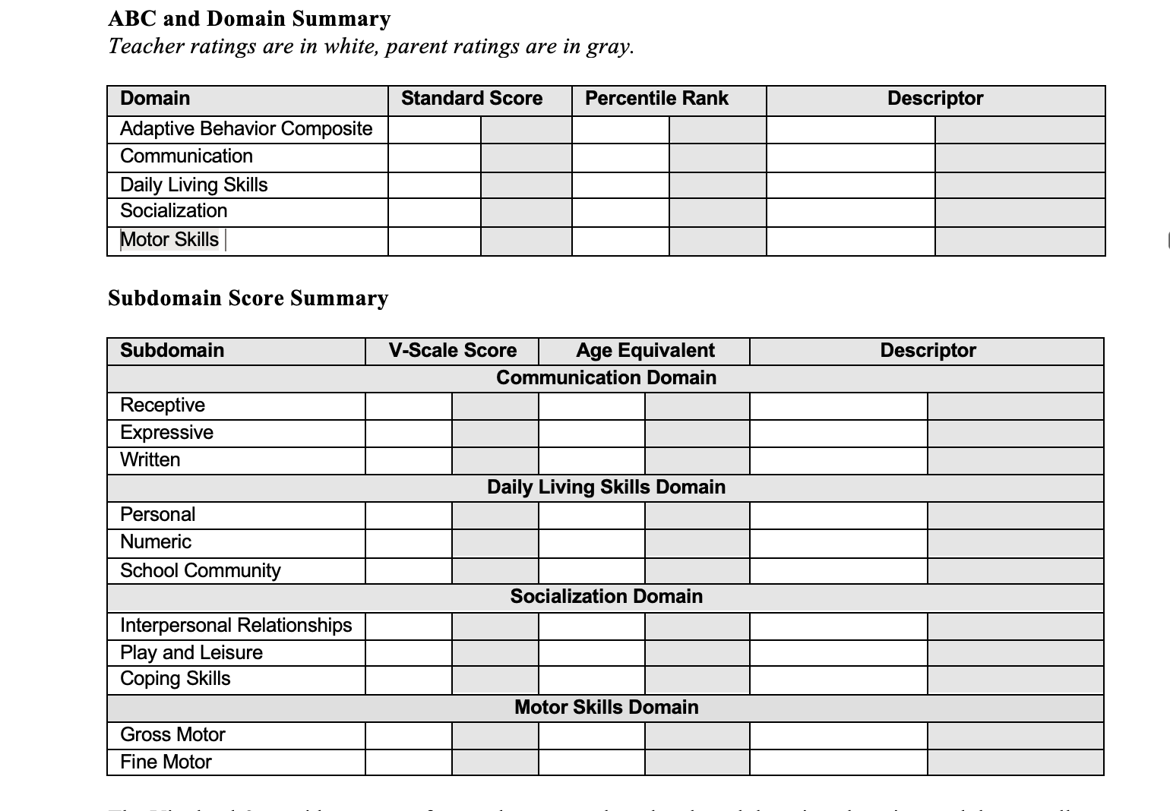
Vineland Adaptive Behavior Scales

Slide 16
Adaptive Behavior: issues to consider
Intellectual disability or Specific Learning Disability
Lack of ability or lack of opportunity?
Impact of pandemic on culturally established expectations

Slide 17
How would the following impact a child’s adaptive behaviors?
Mental Illness
Trauma
Neurodivergence

Slide 18
Documentation of Evaluation
One sentence – information about student
One sentence – PLOP
One sentence – Family situation
One sentence – Adaptive behavior
One sentence – school history
Once sentence – needs/recommendations
Strengths-based!

Slide 19
Anti-oppressive Assessment
Context Factors
Availability of basic needs
Experiences of trauma and prolonged stress
Language and culture
Assessment in dominant language
Cultural norms and communication expectations
Opportunity to practice
Assessment practices
Multiple sources of information
Would special education placement pathologize contextual factors?

Slide 20
Types of Specific Learning Disabilities
Dyslexia
Dyscalculia
Dysgraphia
Oral/written Language Disorder
Nonverbal Learning Disability

Slide 21
Criteria for Emotional Disability (IDEA definition)
An inability to learn that cannot be explained by intellectual, sensory, or health factors
An inability to build or maintain satisfactory interpersonal relationships with peers and teachers
Inappropriate types of behavior or feelings under normal circumstances
A general pervasive mood of unhappiness or depression
A tendency to develop physical symptoms or fears associated with personal or school problems

Slide 22
What does this mean?
“For a long period of time and to a marked degree”

Slide 23
Diagnostic Dilemmas for ED Label
Trauma vs. ED
MH Diagnosis vs. ED
Special education vs. non-special education support
Adverse Impact dilemma
Child who has police contact in community
Protection from punishment and displacement
Child who needs embedded services

